Slide 1
Neural Networks and Deep Learning
Units in Neural Networks
Adapted from slides by Dan Jurafsky, Stanford University
Notes:
Here we introduce the individual computing unit that makes up neural networks.

Slide 2
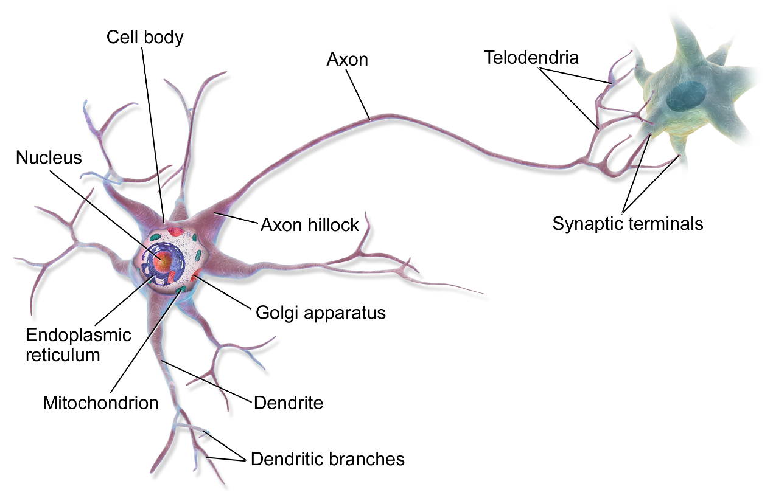
This is in your brain
By BruceBlaus - Own work, CC BY 3.0, https://commons.wikimedia.org/w/index.php?curid=28761830
Notes:
Neural networks are called neural because their origins lie in the McCulloch-Pitts neuron, which was a 1943 simplified model of the human neuron as a kind of computing element that could be described in terms of propositional logic. But the modern use in language processing no longer draws on these early biological inspirations and the name neural is really just a kind of historical remnant.

Slide 3
Neural Network Unit This is not in your brain
Output value
Non-linear transform
Weighted sum
bias
Weights
Input layer
Notes:
Instead, a modern neural network is a network of small computing units, each of which takes a vector of input values and produces a single output value.
Over the next few lectures we'll introduce these units and see how they connect together into feedforward networks, so called because the computation proceeds iteratively from one layer of units to the next. The use of modern neural nets is often called deep learning, because modern networks are often deep (have many layers).
The building block of a neural network is a single computational unit. A unit takes a set of real valued numbers as input, performs some computation on them (combining with weights and biases and a non-linear transform), and produces an output. Let's see this in more detail.

Slide 4
Neural unit
Take weighted sum of inputs, plus a bias
Instead of just using z, we'll apply a nonlinear activation function f:
Notes:
At its heart, a neural unit is taking a weighted sum of its inputs, with one additional term in the sum called a bias term. Given a set of inputs x1...xn, a unit has a set of corresponding weights w1...wn and a bias b, so the weighted sum z can be represented as:
Often it’s more convenient to express this weighted sum using vector notation, i.e. a scalar z computed from the dot product of a weight vector w and an input vector x, plus a scalar bias b
Finally, instead of using z, a linear function of x, as the output, neural units
apply a non-linear function f to z. We will refer to the output of this function as the activation value for the unit, a. Since we are just modeling a single unit, the activation for the node is in fact the final output of the network, which we’ll generally call y. So the value y is defined as: y=a= f(z)

Slide 5
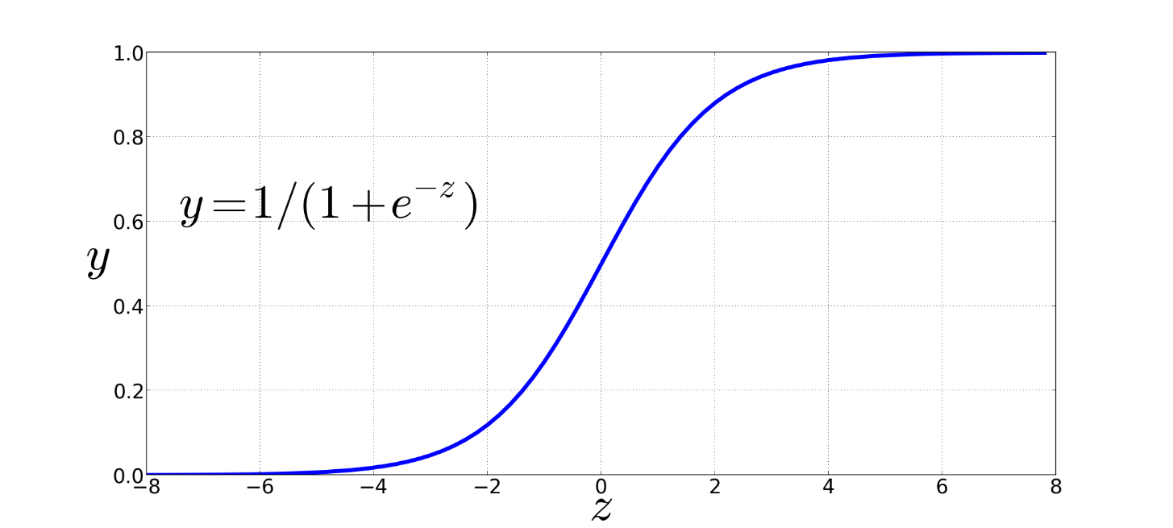
Non-Linear Activation Functions
Sigmoid
Notes:
We're already seen the sigmoid for logistic regression: 1 over 1 plus exp (-z).
The sigmoid has a number of advantages; it maps the output into the range [0,1], which is useful in squashing outliers toward 0 or 1. And it’s differentiable, which as we saw is handy for learning

Slide 6
Final function the unit is computing
Notes:
So here's the function that a simple unit with a sigmoid activation function is computing from an input x, a weight vector w, and a bias term b

Slide 7
Final unit again
Output value
Non-linear activation function
Weighted sum
bias
Weights
Input layer
Notes:
And here's our picture of the unit again, showing the pieces

Slide 8
An example
Suppose a unit has:
w = [0.2,0.3,0.9]
b = 0.5
What happens with input x:
x = [0.5,0.6,0.1]
Notes:
Let’s walk through an example just to get an intuition. Let’s suppose we have a unit with the following weight vector and bias , and given the input

Slide 9
An example
Suppose a unit has:
w = [0.2,0.3,0.9]
b = 0.5
What happens with the following input x?
x = [0.5,0.6,0.1]

Slide 10
An example
Suppose a unit has:
w = [0.2,0.3,0.9]
b = 0.5
What happens with input x:
x = [0.5,0.6,0.1]

Slide 11
An example
Suppose a unit has:
w = [0.2,0.3,0.9]
b = 0.5
What happens with input x:
x = [0.5,0.6,0.1]

Slide 12
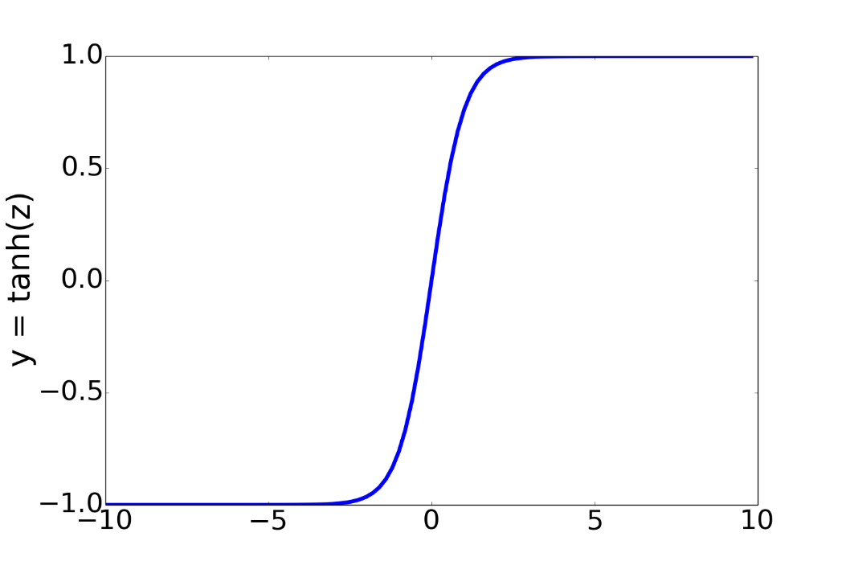
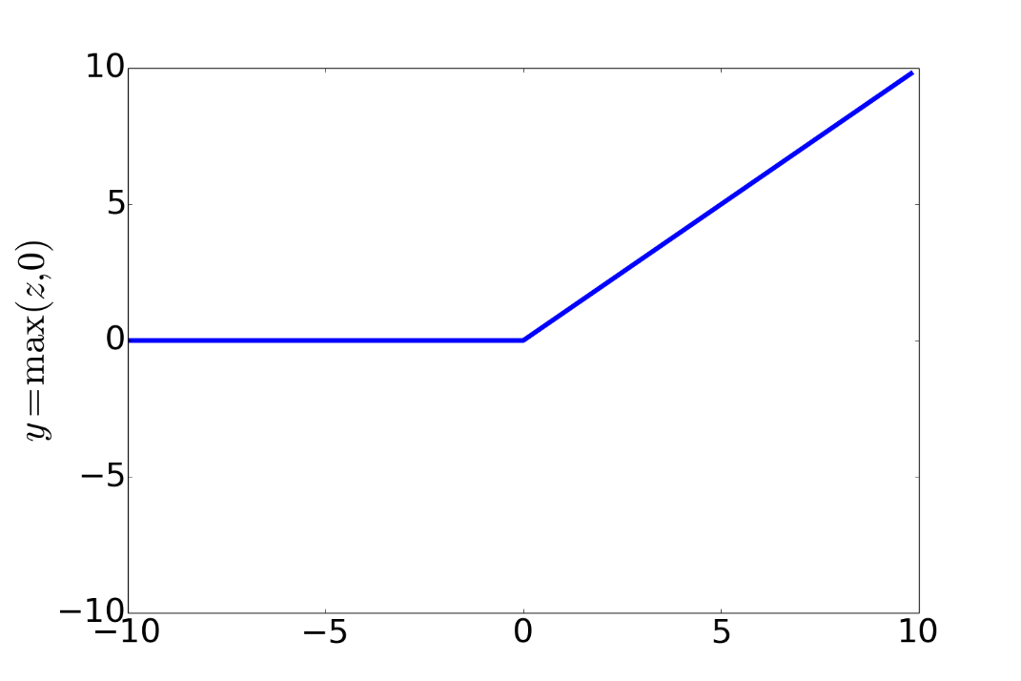
Non-Linear Activation Functions besides sigmoid
Most Common:
ReLU
Rectified Linear Unit
tanh
Notes:
In practice, the sigmoid is not commonly used as an activation function. A function that is very similar but almost always better is the tanh function; tanh is a variant of the sigmoid that ranges from -1 to +1:
The tanh function has the nice properties of being smoothly differentiable and mapping outlier values toward the mean.
The simplest activation function, and perhaps the most commonly used, is the rectified linear unit, also called the ReLU,. It’s just the same as z
when z is positive, and 0 otherwise:
The Rectified Linear Unit function, has nice properties that result from it being very close to linear. In the sigmoid or tanh functions, very high values of z result in values of y that are saturated, i.e., extremely close to 1 and have derivatives very close to 0. Zero derivatives cause problems for learning: gradients that are almost 0 cause the error signal to get smaller and smaller until it is too small to be used for training, a problem called the vanishing gradient problem. Rectifiers don’t have this problem, since the derivative of ReLU for high values of z is 1 rather than very close to 0.

Slide 13
Simple Neural Networks and Neural Language Models
The XOR problem
Notes:
The power of neural networks comes from combining these units into larger networks. One of the most clever demonstrations of the need for multi-layer networks was the early proof by Minsky and Papert (1969) that a single neural unit cannot compute some very simple functions of its input.

Slide 14
The XOR problem
Minsky and Papert (1969)
Can neural units compute simple functions of input?
Notes:
Consider the task of computing elementary logical functions of two inputs, like AND, OR, and XOR. As a reminder, here are the truth tables for those functions:

Slide 15
Perceptrons
A very simple neural unit
Binary output (0 or 1)
No non-linear activation function
Notes:
This example was first shown for the perceptron, which is a very simple neural unit that has a binary output and does not have a non-linear activation function. The output y of a perceptron is 0 or 1, and is computed as follows (using the same weight
w, input x, and bias b we've seen already

Slide 16
Easy to build AND or OR with perceptrons
AND
OR
Notes:
It’s very easy to build a perceptron that can compute the logical AND and OR functions of its binary inputs
Here's an example of
logical AND, showing weights w1 = 1 and w2 = 1 and bias weight b = −1 and logical OR, showing weights w1 = 1 and w2 = 1 and bias weight b = 0. These weights/biases are just one from an infinite number of possible sets of weights and biases that would implement the functions.

Slide 17
Not possible to capture XOR with perceptrons

Slide 18
Why? Perceptrons are linear classifiers
Perceptron equation given x₁ and x₂, is the equation of a line
w₁x₁ + w₂x₂ + b = 0
(in standard linear format: x₂ = (−w₁/w₂)x₁ + (−b/w₂) )
This line acts as a decision boundary
0 if input is on one side of the line
1 if on the other side of the line
Notes:
Why? Crucially, the perceptron is a linear classifier. For a two-dimensional input x1 and x2, the perception equation, w1 x1 + w2 x2 + b = 0 is the equation of a line. (We can see this by putting it in the standard linear format: x2 = (−w1/w2)x1 + (−b/w2).)
This line acts as a decision boundary in two-dimensional space in which the output 0 is assigned to all inputs lying on one side of the line, and the output 1 to all input points lying on the other side of the line
If we had more than 2 inputs, the decision boundary becomes a hyperplane instead of a line, but the idea is the same, separating the space into two categories.

Slide 19
Decision boundaries
XOR is not a linearly separable function!
Notes:
These figures shows the possible logical inputs (00, 01, 10, and 11) and the line drawn by one possible set of parameters for an AND and an OR classifier. Notice that there is simply no way to draw a line that separates the positive cases of XOR (01 and 10) from the negative cases (00 and 11).
CLICK
We say that XOR is not a linearly separable function. Of course we could draw a boundary with a curve, or some other function, but not a single line.

Slide 20
Solution to the XOR problem
XOR can't be calculated by a single perceptron
XOR can be calculated by a layered network of units.
ReLU
ReLU
Notes:
Let’s see an example of how to compute XOR using two layers of ReLU-based units.
The middle layer (called h) has two units, and the output layer (called y) has one unit. These weights and biases will computes XOR.
Consider input x = [0, 0] ]. If we multiply each input value by the appropriate weight, sum, and then add the bias b, DO THIS ON SLIDE we get the vector [0 -1] apply the ReLU and we get [0 0], and the final value is 0.

Slide 21
The hidden representation h
(With learning: hidden layers will learn to form useful representations)
Notes:
It’s also instructive to look at the intermediate results, the outputs of the two hidden nodes h1 and h2.
Here are the values of the h layer for all 4 inputs. Notice that hidden representations of the two input points x = [0 1] and x = [1 0] (the two cases with XOR output = 1) are merged to the single point h = [1 0]. The merger makes it easy to linearly separate the positive and negative cases of XOR. In other words, we can view the hidden layer of the network as forming a useful representation for the input.
In this example we just stipulated the weights. But for real examples the weights for neural networks are learned automatically using the error backpropagation algorithm we'll turn to. That means the hidden layers will learn to form useful representations. This intuition, that neural networks can automatically learn useful representations of the input, is one of their key advantages,

Slide 22
Simple Neural Networks and Neural Language Models
Feedforward Neural Networks
Notes:
Here we introduce the simple feedforward network. While NLP uses many more complex kinds of networks (the RNN, the Transformer, attention), the simple feed-forward network is still an important tool, and underlies these more complex kinds of networks.

Slide 23
Feedforward Neural Networks
Can also be called multi-layer perceptrons (or MLPs) for historical reasons
Notes:
A feedforward network is a multilayer network in which the units are connected with no cycles; the outputs from units in each layer are passed to units in the next higher layer, and no outputs are passed back to lower layers.
For historical reasons feed-forward netowrks can also be called multi-layer perceptrons or MLPs (although they aren't technically composed of perceptrons any more).
Simple feedforward networks have three kinds of nodes: input units, hidden units, and output units.

Slide 24
softmax: a generalization of sigmoid
For a vector z of dimensionality k, the softmax is:
Example:

Slide 25

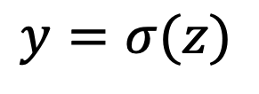

Two-Layer Network with scalar output
$$y=σ(z)$$
y is a scalar
Output layer
(σ node)
$$z=Uh$$
U
hidden units
(σ node)
Could be ReLU
Or tanh
W
b
Input layer
(vector)
x₁
x_{n}
+1
Notes:
Here are the final equations for a feedforward network with a single hidden layer, which takes an input vector x, outputs a probability distribution y, and is parameterized by weight matrices W and U and a bias vector b:

Slide 26
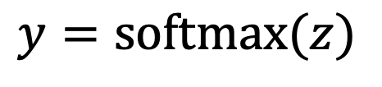
Two-Layer Network with softmax output
Output layer
(σ node)
$$y=\text{softmax}(z)$$
$$z=Uh$$
U
y is a vector
hidden units
(σ node)
Could be ReLU
Or tanh
W
b
Input layer
(vector)
x₁
x_{n}
+1
Notes:
What if you have more than two output classes?
If we are doing multinomial classification, such as assigning a part-of-speech tag, we just add more output units (one for each class).
So we might have one output node for each potential part-of-speech, whose output value is the probability of that part-of-speech,
The output layer thus gives a probability distribution across the output nodes. We use the softmax to compute this distribution, just as for multinomial logistic regression
That means we can think of a neural network classifier with one hidden layer as building a vector h which is a hidden layer representation of the input, and then running standard logistic regression on the features that the network develops in h. By contrast, in Chapter 5 the features were mainly designed by hand via feature templates. So a neural network is like logistic regression, but (a) with many layers, since a deep neural network is like layer after layer of logistic regression classifiers, and (b) rather than forming the features by feature templates, the prior layers of the network induce the feature representations themselves.

Slide 27
Simple Neural Networks and Neural Language Models
Training Neural Nets: Overview
Notes:
How do we train neural networks? Let's start with an overview

Slide 28
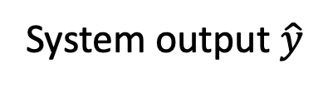
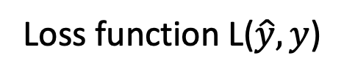
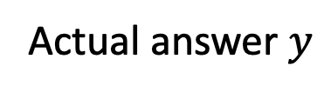
Intuition: training a 2-layer Network
Actual answer $y$
Loss function L($\hat{y},y$)
System output $\hat{y}$
U
Backward pass
Forward pass
W
x₁
x_{n}
Training instance
Notes:
The intuition of neural net training is the forward computation of the loss and the backward computation of the weight updates. Given an input x,
CLICK
we run a forward pass through the network, computing the system output y-hat. CLICK
Then we compare y-hat to the true answer y, CLICK to get a loss for this example. CLICK Then CLICK we do a backward pass through the network, computing the gradients we need to update the weights.

Slide 29
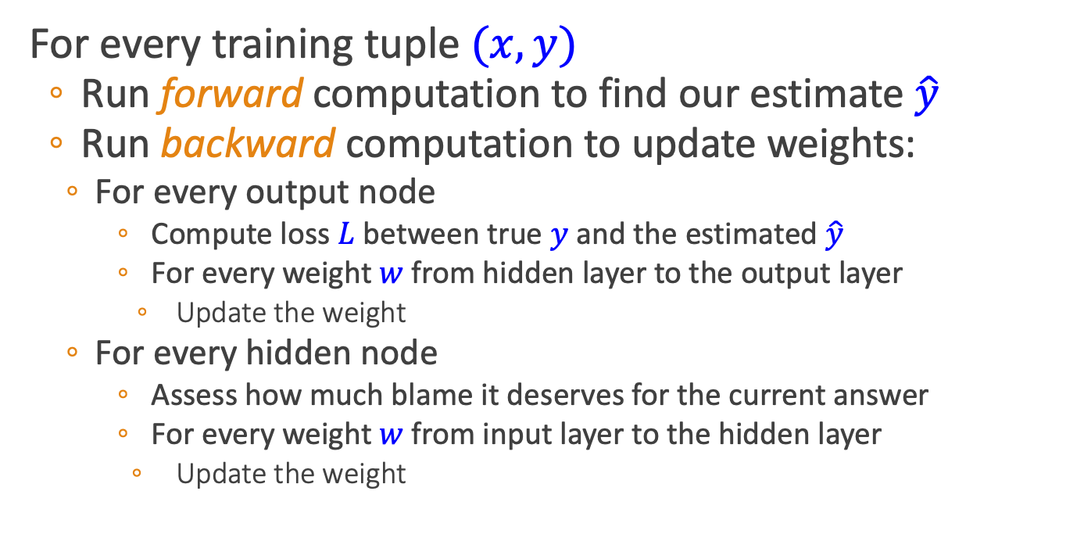
Intuition: Training a 2-layer network
For every training tuple $(x,y)$
Run forward computation to find our estimate $\hat{y}$
Run backward computation to update weights:
For every output node
Compute loss $L$between true $y$ and the estimated $\hat{y}$
For every weight $w$from hidden layer to the output layer
Update the weight
For every hidden node
Assess how much blame it deserves for the current answer
For every weight $w$from input layer to the hidden layer
Update the weight
Notes:
Let's

